Slide 1


FISH FOTOGRAPHY
Saira J. Barlas
Summer Undergraduate Intern
Brian Stone

Slide 2
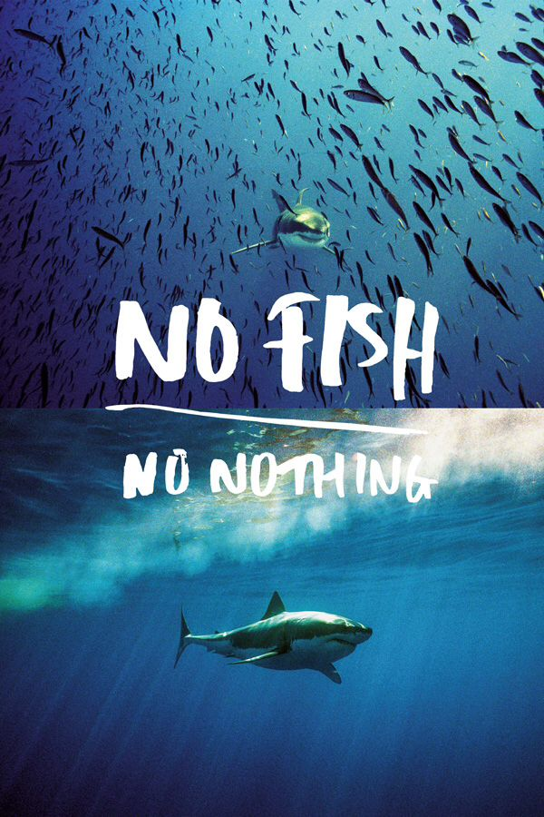

Slide 3
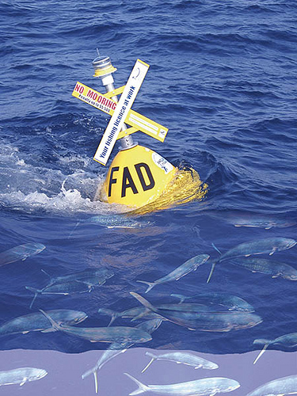

Slide 4
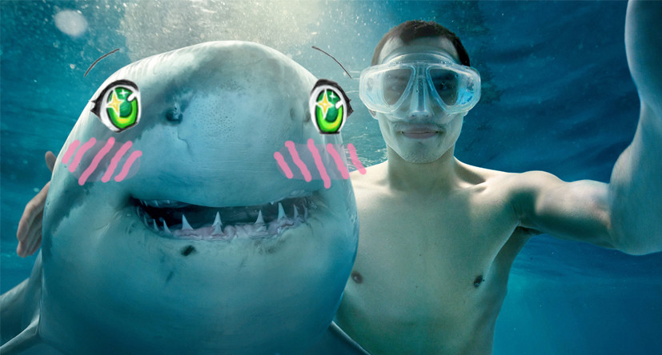


Slide 5

Thank you

